Slide 1

02 DECEMBER 2024
Traffic Prediction and Taxi Scheduling
Name: Murtaza Khasamwala
Major: Artificial Intelligence
Course: Numerical Methods

Slide 2
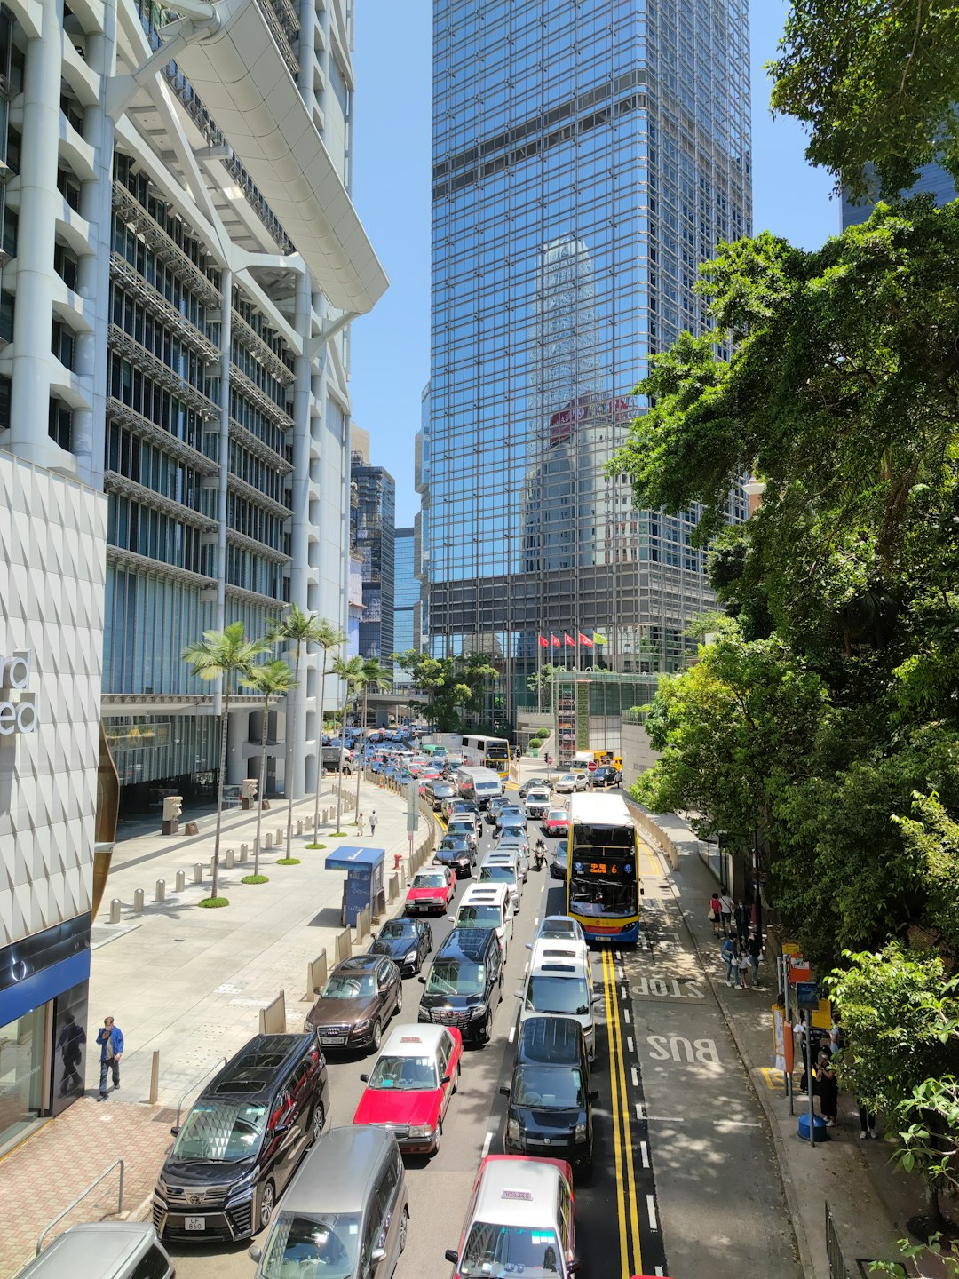
02 DECEMBER 2024
AUTHOR
INTRODUCTION
Problem Statement: "Predicting Traffic Volume in Urban Areas Using Weather and Temporal Features"
Urban traffic congestion is a major issue that impacts daily commuting, environmental sustainability, and overall city management. The ability to predict traffic volume accurately can help improve urban planning, optimize traffic light control systems, and enhance transportation management.
This project aims to develop a machine learning model that can predict traffic volume in urban areas based on multiple factors, including weather conditions, day of the week, time of day, holidays, and weekend patterns. By leveraging these features, the goal is to predict traffic volume in advance and provide actionable insights for urban planners, traffic management systems, and city authorities to reduce congestion, improve traffic flow, and enhance the overall transportation experience for residents.

Slide 3
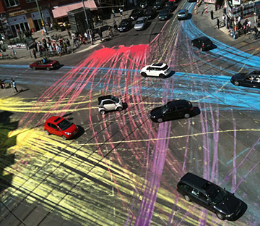

02 DECEMBER 2024
AUTHOR
Background
Urban Traffic Congestion:
Increasing traffic congestion in urban areas, leading to delays, higher fuel consumption, and pollution.
Economic costs, including lost time and productivity.
Need for Traffic Prediction:
Efficient traffic management is essential for reducing congestion and improving city mobility.
Real-time predictions can optimize public transportation and traffic flow.
Machine Learning and Traffic Prediction:
Recent studies show machine learning models, including Random Forest and XGBoost, are effective in predicting traffic.
Weather conditions, time of day, and city-specific features are critical for accurate prediction.
Technological Advancements:
IoT-based traffic monitoring systems providing real-time data for analysis.
Smart Traffic Signals and Weather-integrated Traffic Prediction.

Slide 4
02 DECEMBER 2024
AUTHOR
Distant Past Methods
Fixed-Time Traffic Signals:
Operated on pre-set timers.
Limited in flexibility.
Manual Traffic Control:
Officers directed traffic.
Labor-intensive and prone to error.
Road Expansion:
More lanes to accommodate traffic.
Induced demand often worsened congestion.
Roundabouts:
Controlled intersection traffic flow.
Less effective in high-traffic areas.
One-Way Streets:
Improved flow by reducing head-on collisions.
Could create longer detours.

Slide 5
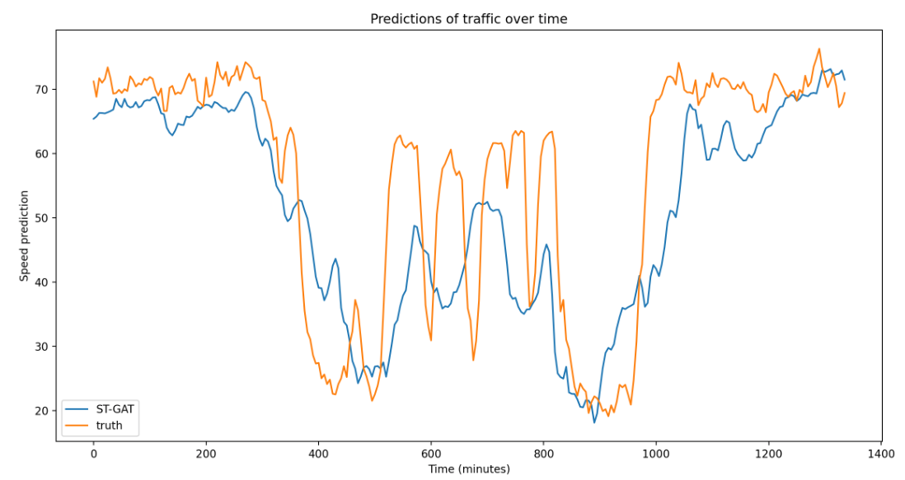
02 DECEMBER 2024
AUTHOR
Recent Past Research
Research 1: Machine Learning for Traffic Prediction (2020)
Focus: Predicting urban traffic patterns using Random Forest and Support Vector Machines.
Findings: Achieved up to 80% prediction accuracy by integrating real-time traffic data and weather conditions.
Contribution: Demonstrated the impact of environmental factors (e.g., rain, fog) on traffic volume.
Research 2: Smart Cities and IoT (2021)
Focus: Using IoT sensors for real-time traffic data collection in smart cities.
Findings: IoT-based systems significantly reduced traffic congestion in monitored areas.
Contribution: Showcased integration of smart traffic signals with predictive models.

Slide 6
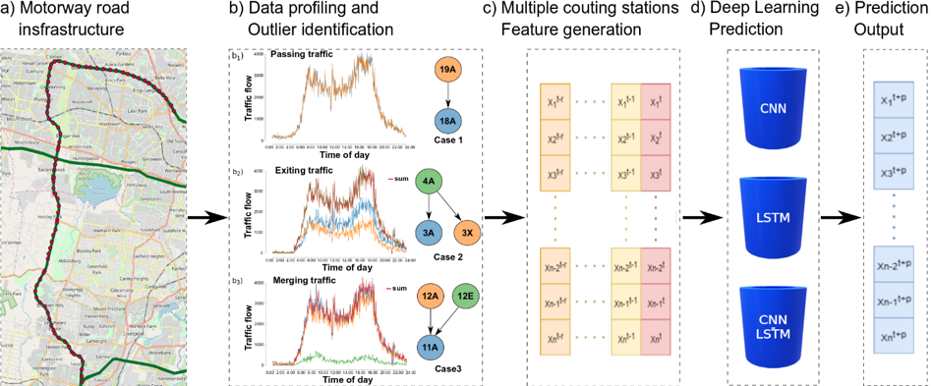
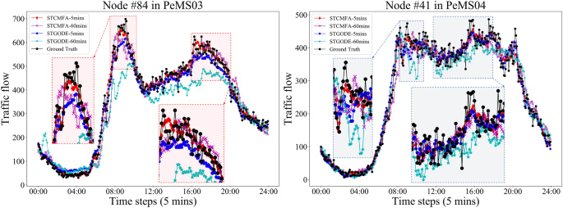
02 DECEMBER 2024
AUTHOR
Recent Past Research
Research 3: Deep Learning for Traffic Volume (2022)
Focus: Employing Long Short-Term Memory (LSTM) models to predict traffic congestion.
Findings: LSTM outperformed traditional models with 10% better prediction accuracy during peak hours.
Contribution: Highlighted the ability of deep learning models to capture long-term temporal dependencies in traffic data.
Research 4: Weather-Integrated Traffic Systems (2023)
Focus: Incorporating real-time weather data to improve traffic flow prediction.
Findings: 15% improvement in prediction accuracy using XGBoost with weather features.
Contribution: Introduced dynamic weather-traffic models, particularly effective during adverse weather.

Slide 7
02 DECEMBER 2024
AUTHOR
Project Phases

Slide 8
02 DECEMBER 2024
AUTHOR
Data Gathering
Find credible sources of data on the internet, free and paid.
NYC Dataset(Traffic Data), Meteor.com(Weather)
Data Preprocessing
Inspect dataset to know detailed insights about the features, data types, missing values, duplicate value.
Month, Day, Year, Traffic status, Weather classification etc… (categorical)
Feature Generation
Generate proxies for missing features through mathematical or domain knowledge
Weather Classification (meteor.com), Traffic Volume (No of pickups per location hour), Holiday, is_weekend
Convert into categorical and numerical data types
Traffic Volume, number of pickups….etc (Numerical)
Date and time as Pandas Data time object
Modelling
Prepare data set for modelling, encode categorical variables.
Remove null values or fill appropriately, remover duplicate values.
Check for corelation between variables : Drop highly co related variable for redundancy
Ex: Time_of_pickup
Extract feature and target variable: split data in test and train datasets.
Evaluation and Fine Tuning
Calculate MAE, MSE, R2.
Mean Absolute Error: 85 : R2 Score: 0.11

Slide 9
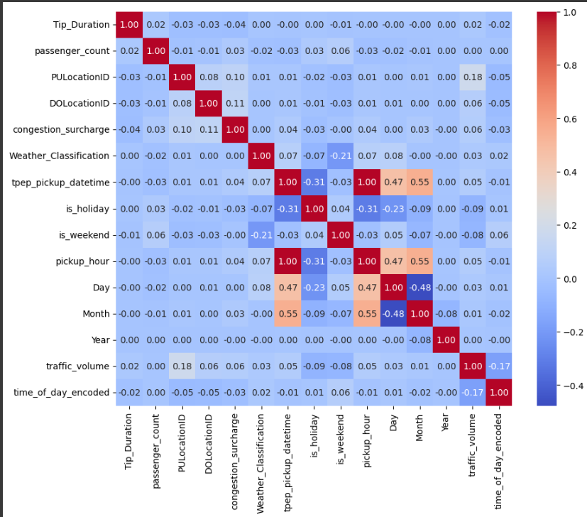
02 DECEMBER 2024
AUTHOR
PHASE 1
PHASE 2
PHASE 3
PHASE 4
PHASE 5

Slide 10
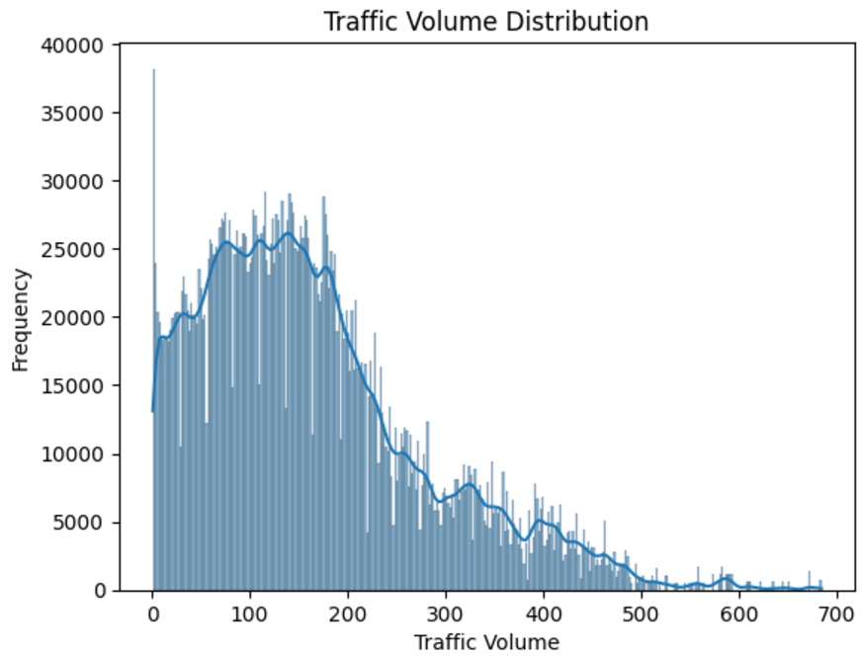
AUTHOR

Slide 11
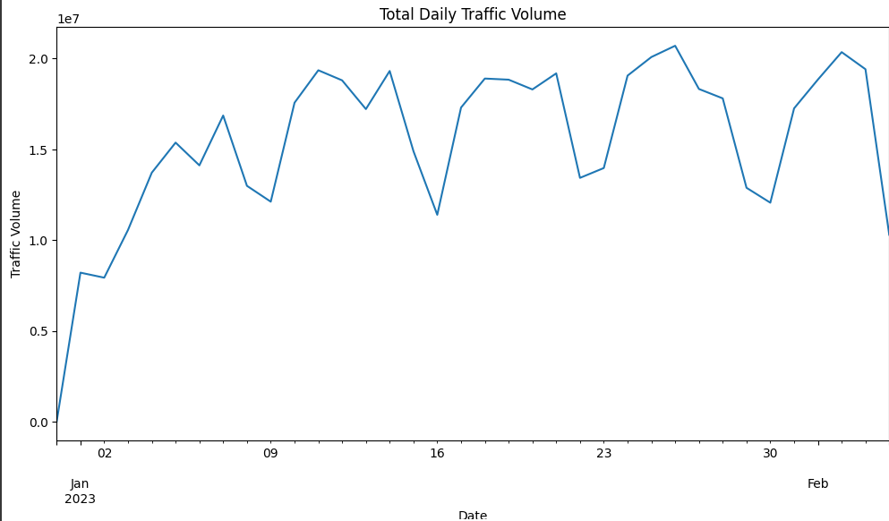
AUTHOR

Slide 12
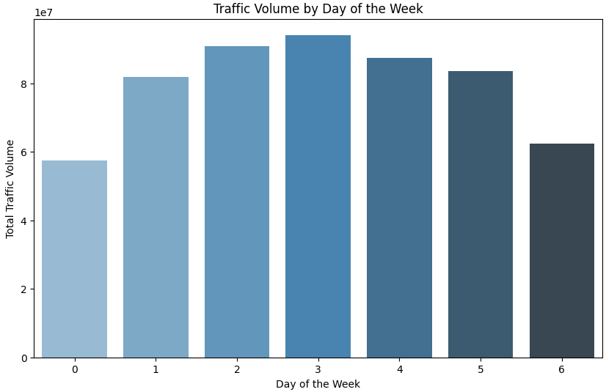
AUTHOR

Slide 13
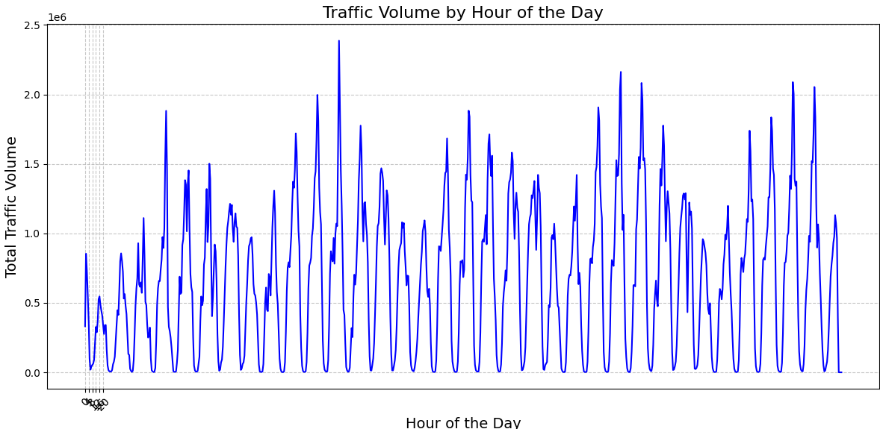
AUTHOR

Slide 14
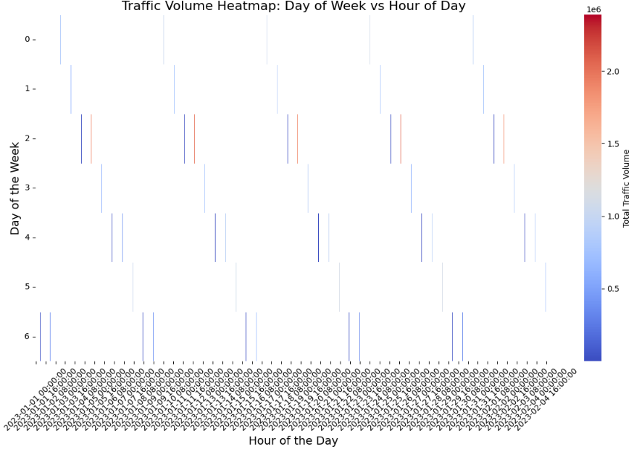
AUTHOR

Slide 15
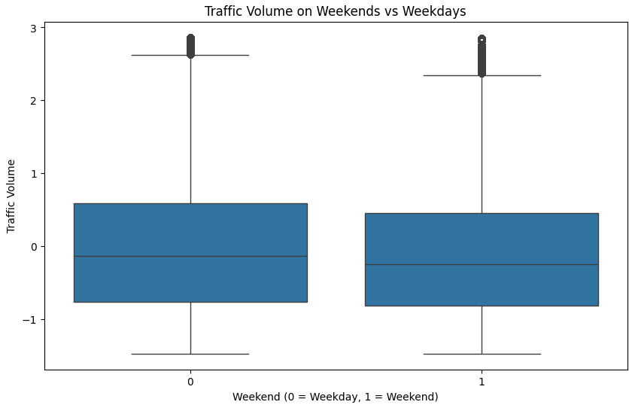
AUTHOR

Slide 16
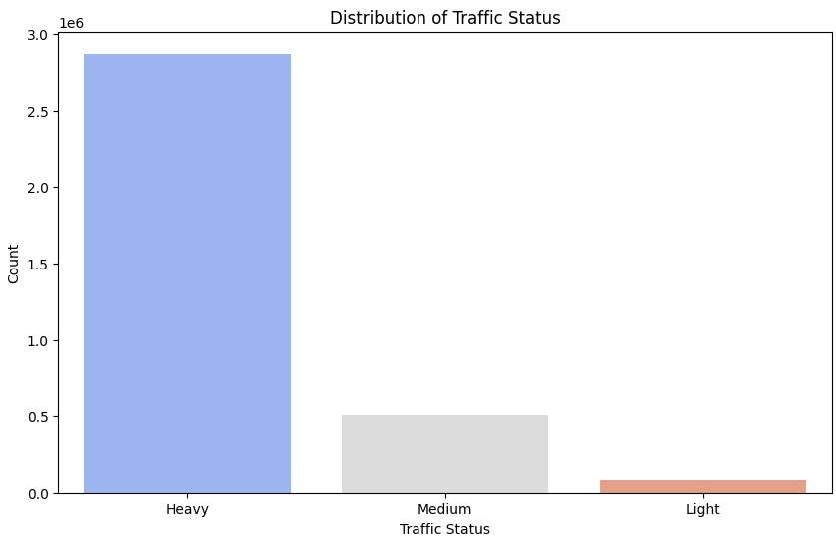
AUTHOR

Slide 17

02 DECEMBER 2024
AUTHOR
MODEL EVALUATION
Performance Metrics
By understanding these metrics, we can fine-tune our algorithms and make more reliable traffic predictions.
Metric | Value
XGBoost - Mean Absolute Error | 84.96346345378245
XGBoost - R² Score | 0.11536318063735962
Feature | Importance
is_weekend | 0.331348
is_holiday | 0.282106
time_of_day_encoded | 0.255800
Day | 0.057041
Month | 0.037870
Weather_Classification | 0.035834
Year | 0.000000

Slide 18




02 DECEMBER 2024
AUTHOR
Challenges & Solutions
Resources
Data cleaning and processing
Weather data gathering
Dealing with Null value and redundant features
Google Colab Environment
Purchased Google Drive premium
Batch Processing and sequential processing
Using Meteor.com free API call, gathered hourly weather data from local weather stations
Null values check and duplicated values check.
Weather data and Traffic data match using rounded pickup time variable
Conversion of all categories to numeric or object type using Label and hot encoding strategies
Null values removed and replaced by either using mode or quantile fill strategy
Co relation check to detect colinearity

Slide 19
02 DECEMBER 2024
AUTHOR
CONCLUSON
Summary of key points and takeaways
Model Performances:
1. XGBoost and Random Classifier yielded similar performance with Mean Absolute Errors around 84.96 and R2 scores near 0.115
2. XGBoost was slightly better in terms of feature importance analysis, especially highlighting is_weekend is_holiday and time_of_day as key predictors of the traffic volume
Key Takeaways:
Time and Holiday – based features have the greatest influence on traffic prediction, reflecting real-world patterns of traffic flow
Weather classification had a minimal impact, which may require additional data for better accuracy in weather=specific condition

Slide 20
02 DECEMBER 2024
AUTHOR
CONCLUSON
Summary of key points and takeaways
Future Improvements:
Explore additional features such as traffic incidents or public events
Implement more advanced tuning of hyperparameters for boosting model performance
Final Outcome:
1. Our current model provides strong foundation for predicting traffic volume for high- accuracy predictions

Slide 21
02 DECEMBER 2024
Thank You
Do you have any questions or feedback?

